Slide 1


School of Computer Science & IT Department of BCA
INTRODUCTION TO LINUX(20BCA1C06)
MODULE 1: INSTALLING LINUX/ UBUNTU
Faculty : Dr. Ananta Ojha

Slide 2
Lab Session -1
Installing Linux / Ubuntu
There are several ways to install Linux.
You can clean everything from your computer system and install Linux.
You can dual boot Linux with Windows and choose one of the operating systems at the boot time.
You can even install Linux on top of your Windows OS, using virtual machine / virtualization.
Option No- 3 is a popular choice for beginners of Linux.

Slide 3
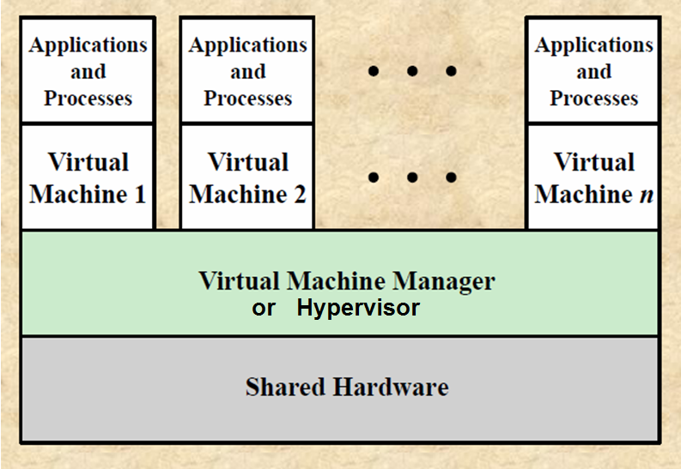
Virtualization
Virtualization process enables one physical resource to function as multiple logical resources such that a large number of users can share the physical resource.
Hypervisor:
Virtualization is implemented using virtual machine monitor (VMM), or hypervisor.
The hypervisor is a software that abstracts the underlying physical computer and enables creation of virtual machines.
The virtual machines share the resources of the physical machine.
Virtual Machine:
A Virtual Machine (VM) is a software representation of a physical computer and can behave exactly as a physical computer.
It is configured with one or more processors, memory elements, storage resources, and network ports.
Once the VM is created, it can be powered on like a physical computer; loaded with an operating system, and software applications.
This virtual computer only uses the configured resources instead of all of the resources of the physical host.

Slide 4
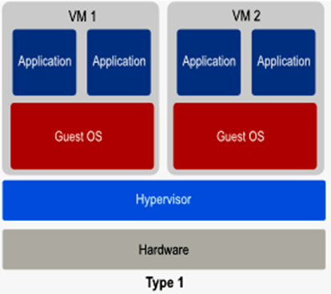
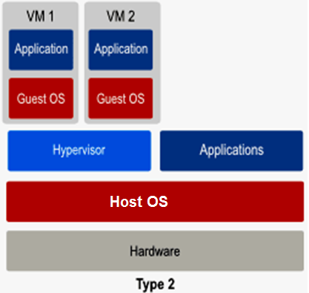
Types of Hypervisor
Hypervisors come in different flavors. Two of them are the most common:
Type-1: Bare Metal or Embedded or Native Hypervisor
It runs directly on the hardware of the physical host and can monitor guest operating systems that run above the hypervisor.
Examples: VMware’s vSphere; Microsoft’s Hyper-V; Oracle VM Server; Open-source Linux-based KVM
Type-2: Hosted Hypervisors
The hypervisor is installed on an operating system of the physical computer and then supports other Guest operating systems above it.
Examples: VMware Workstation, Oracle’s open source VirtualBox, Microsoft VirtualPC, open source Xvisor,

Slide 5
Installing Linux inside Windows using VirtualBox
VirtualBox is free and open source virtualization software (Type-2 Hypervisor) from Oracle. It enables you to install other operating systems in virtual machines. It is recommended that your system should have at least 4GB of RAM to get decent performance from the virtual operating system.
Step 1: Download and install VirtualBox
Go to the website of Oracle VirtualBox and get the latest stable version from here: https://www.virtualbox.org/wiki/Downloads
Step 2: Download the Linux ISO image
Download the ISO file of the Linux distribution from the official website. Download Ubuntu from: https://ubuntu.com/desktop
Step 3: Install Linux using VirtualBox
You have installed VirtualBox and you have downloaded the ISO for Linux. You are now set to install Linux in VirtualBox.

Slide 6
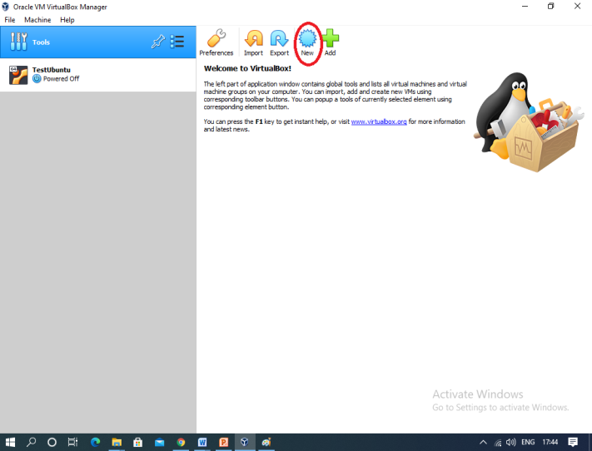
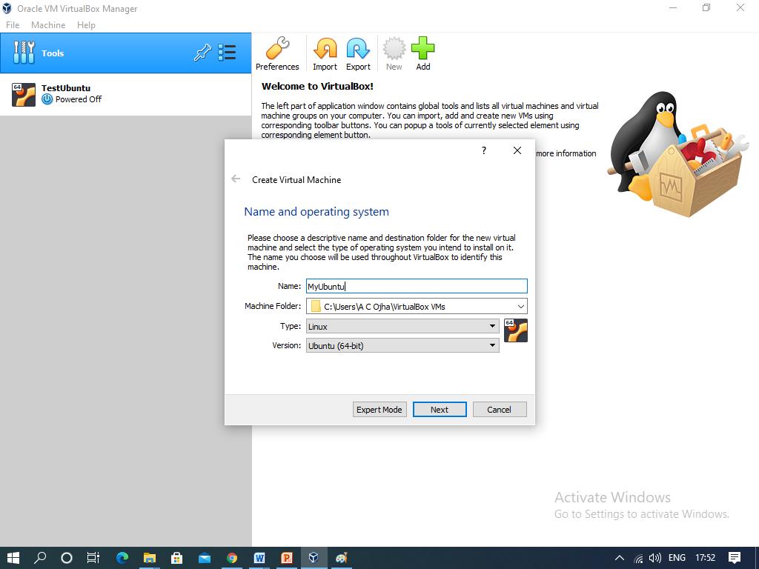
Creating a Virtual Machine
Open VirtualBox and Click New. It opens a pop-up menu.
Enter a name for your virtual machine in the Name field.
Select Linux as the OS in the Type drop-down box.
Select Ubuntu (64-bit) in the Version drop-down box.
Click Next button. It will take you to another window.

Slide 7
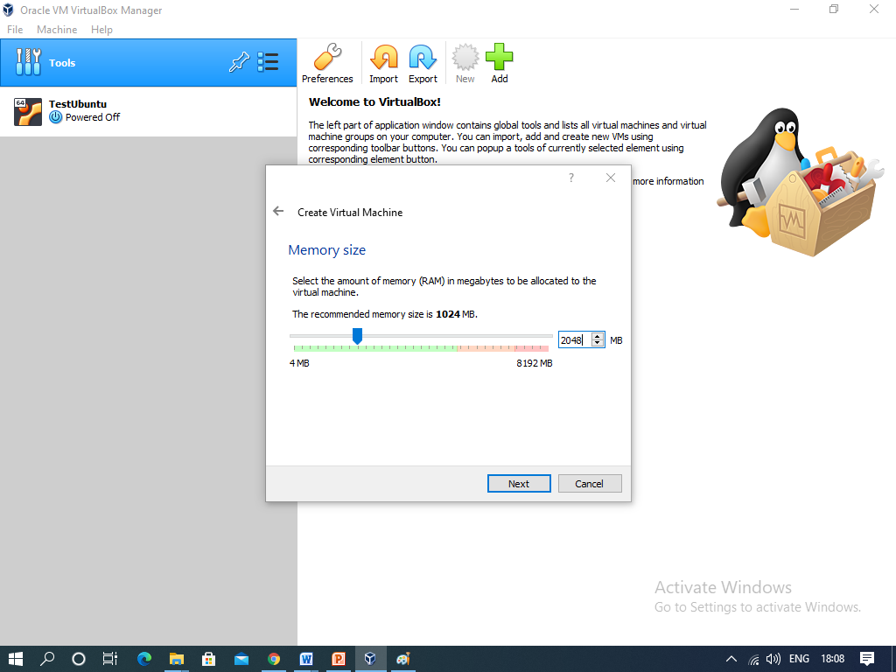
Configuring a Virtual Machine
Select an amount of RAM to use (for example 2 GB). Then Click Next. It will take you another window.
Create your virtual machine's virtual hard drive. Choose Create a virtual hard disk now option. Click Create. It will take you to another window.
For Hard disk file type choose VDI(VirtualBox Disk Image). Click Next. It will take you to another window.
For Storage on physical had disk choose Dynamically allocated. Click Next. It will take you to another window.
Consider default values for File location and size for virtual hard disk file. Click Create. It will create a virtual machine.

Slide 8
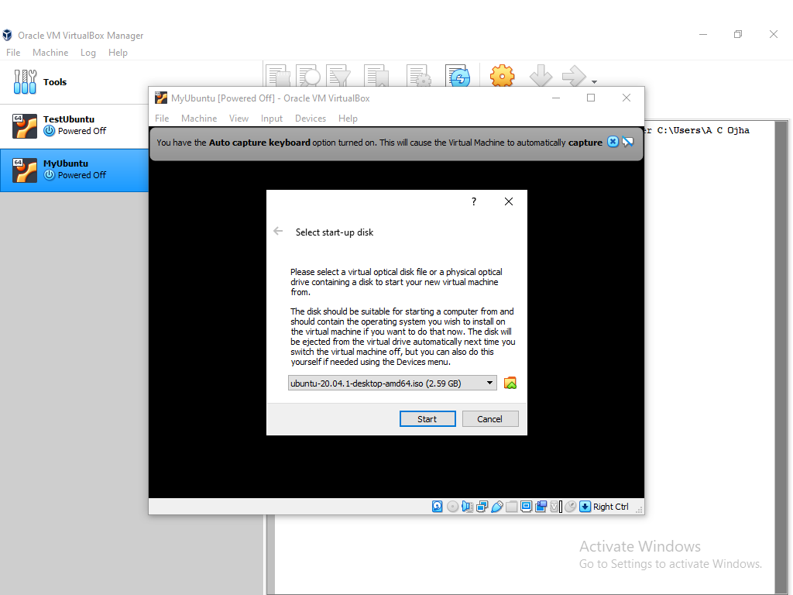
Installing Ubuntu
Double click your virtual machine just created. It's on the left side of the VirtualBox window. It will open a popup window.
Select the Ubuntu ISO file from the folder. It should be preferably in “VirtualBox VMs” folder located in Users folder of your computer. Click Start.
Ubuntu will begin running. Click Install Ubuntu.

Slide 9

THANK YOU Any questions…?

